Slide 1
NLP BASED REPORT SUMMARISATION
Problem statements
Submitted by : Sulaikha,Meenakshy,Nayana

Slide 2
Objective:
Develop an NLP-powered AI model that automatically summarizes long traffic enforcement and accident reports into concise, structured summaries for quick decision-making.
Helps officers and policymakers get key insights without reading full reports.
Used an accident dataset with details like date, time, location, type, and casualties.
Used ChatGPT to generate large structured summaries for better analysis.

Slide 3
Data preprocessing
Cleaning: Steps taken to clean the text data.
Lowercasing
Removing punctuation
Tokenization
Removing stopwords
LSTM is a type of Recurrent Neural Network (RNN) designed to handle sequential data. It is particularly effective for tasks involving sequences, such as text, time series, or any data where the order of elements is important. LSTMs are capable of learning long-term dependencies, making them suitable for tasks like text summarization, translation, and prediction.

Slide 4
Steps in Using LSTM for Your Data
Data Preparation
Cleaning:
Tokenization: The cleaned text is tokenized into sequences of words or characters. This is necessary because neural networks operate on numerical data,
Padding: The sequences are padded to ensure they are of uniform length.
Model Training
Architecture: The LSTM model consists of several layers:
Embedding Layer: Converts the tokenized text into dense vectors of fixed size.
LSTM Layers:
Dense Layer: The final layer that outputs the summary.
Training:

Slide 5
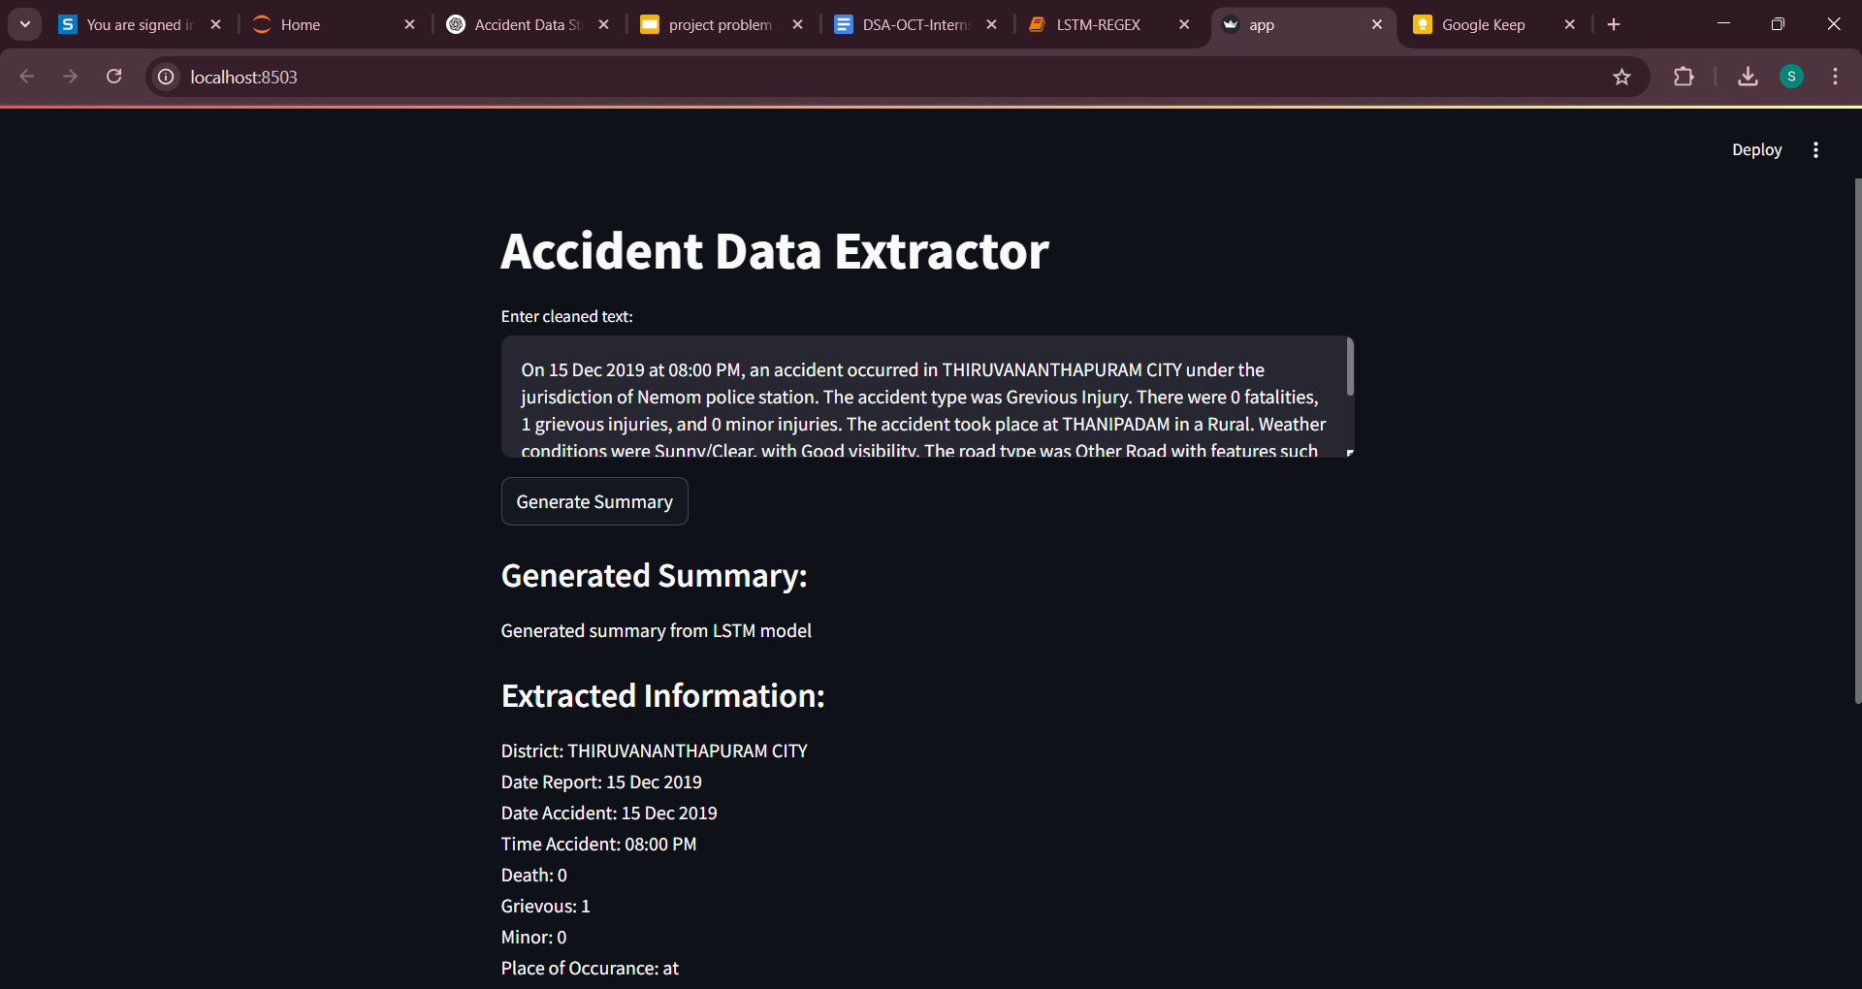

Slide 6
THANKYOU!

